Slide 1
K Means Genetic Algorithm for Wine Dataset Clustering
Bidhan Bashyal, Aarush Mathur

Slide 2
OverView
K Means Clustering
Genetic K Means Clustering
Fitness Function
Selection
Crossover
Mutation
Dataset
Result
Conclusion

Slide 3
K Means Clustering
Unsupervised data analysis in clustering data.
It is most widely used clustering algorithm.
‘n’ number of centroid i.e. no.of clusters are selected and objects are assigned to the cluster based on different index.

Slide 4
GA K Means Algorithm
There have been various GA based K Means algorithm with different variations.
Our method also uses similar approaches.
Tried on 2 different datasets.

Slide 5
Normalization of Data
Data is normalized before used to calculate fitness.
Normalized using standard minmax scaler.

Slide 6
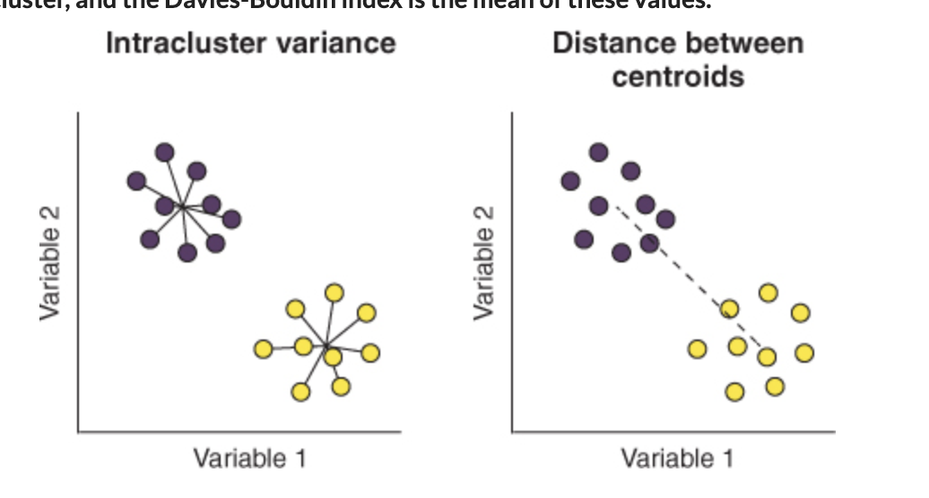
Fitness Function
Davis Bouldin Index as an index for evaluation of each cluster.
DB index performed better compared to other criterion (Silhouette).
This is based on a ratio between variance within cluster and between cluster variance.

Slide 7
Crossover
N number of individuals (i.e. population size).
Chromosome is randomly generated ( length of chromosome=no.of features*no. of max clusters)
One point crossover
Children chromosomes were generated by cross over of two parent chromosome based on their fitness score (initial indexes of parent chromosome have better fitness score than later).
Used Crossover rate as a parameter.

Slide 8
Mutation
Similar to crossover, the mutation rate is also parameter which we provide.
Performs a search that reassigns objects to cluster at lower distance.
Remove from one cluster and add to another.

Slide 9
Selection
Used Rank based selection
Fitness of the chromosome is calculated
Every chromosome is allocated selection probability with respect of its rank.
Chromosome with less Ps is replaced with chromosome with high Ps.

Slide 10
Dataset
Two datasets
Wine Dataset for clustering (13 features such as Alchool, Malic Acid, Ash, Alcalinity,etc)
Iris dataset (4 features)

Slide 11
Results
Our GA based Kmeans method performed better in Iris dataset – 85.3% accuracy compared to 83.3%.
However, didn’t performed better on the Wine Dataset with only 62% compared to 82%.

Slide 12
Discussion
Results show that GA based K means does better in Iris Dataset compared to traditional K means
High number of features?
Selection of parameters such as Number of Individuals, Crossover rate, Selection rate and Mutation rate,

Slide 13
References
1. Pizzuti C., Procopio N. (2017) A K-means Based Genetic Algorithm for Data Clustering. In: Graña M., LópezGuede J.,Etxaniz O., Herrero Á., Quintián H., Corchado E. (eds) International Joint Conference SOCO’16- CISIS’16-ICEUTE’16. SOCO 2016, CISIS 2016, ICEUTE 2016. Advances in Intelligent Systems and Computing, vol 527. Springer, Cham. https://doi.org/10.1007/978-3-319-47364-2_21
2. Krishna, K., Murty, M.N.: Genetic k-means algorithm. IEEE Trans. Syst. Man Cybern. Part B 29(3), 433–439 (1999)
3. Sanghamitra Bandyopadhyay, Ujjwal Maulik, An evolutionary technique based on K-Means algorithm for optimal clustering in RN,Information Sciences,Volume 146, Issues 1–4,2002

Slide 14
THANK YOU

